Slide 1
Scientific Programming
Digital Image Processing
Image Enhancement
(Histogram Processing)
Ankara University
Computer Engineering Department

Slide 2
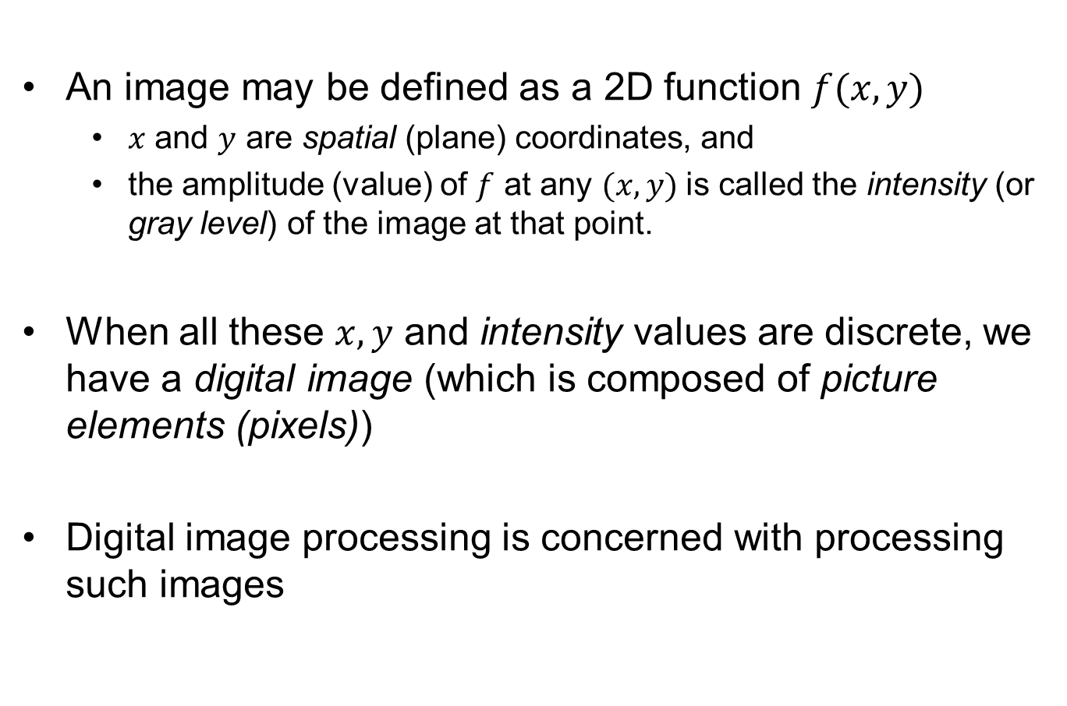
Digital Image and Digital Image Processing
An image may be defined as a 2D function $f(x,y)$
$x$ and $y$ are spatial (plane) coordinates, and
the amplitude (value) of $f$ at any $(x,y)$ is called the intensity (or gray level) of the image at that point.
When all these $x,y$ and intensity values are discrete, we have a digital image (which is composed of picture elements (pixels))
Digital image processing is concerned with processing such images

Slide 3
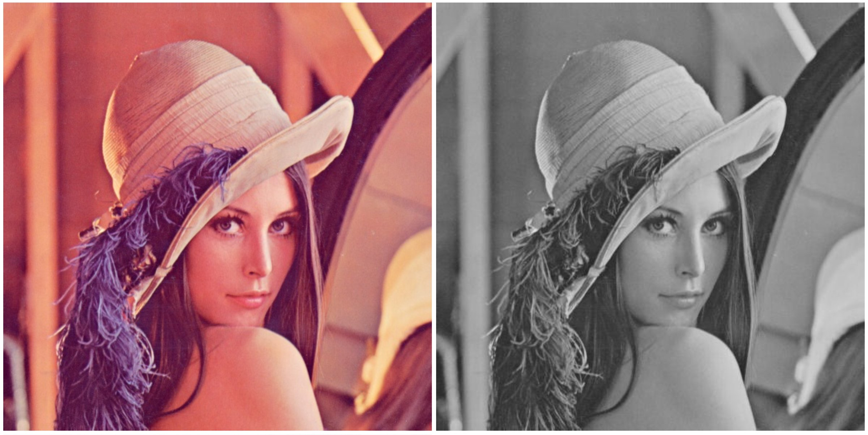
Digital Image Processing
RGB I(m,n,3)
Grayscale I(m,n)

Slide 4
Digital Image Processing
Grayscale images:
The pixel value is a single number that represents the brightness of the pixel.
The most common pixel format is the byte image, where this number is stored as an 8-bit integer giving a range of possible values from 0 to 255.
Typically zero is black, and 255 is considered as white.
Values in between make up the different shades of gray.

Slide 5
Digital Image Processing
An RGB color value is specified with: rgb(red, green, blue).
Each parameter (red, green, and blue) defines the intensity of the color as an integer between 0 and 255.
For example, rgb(0, 255, 0) is rendered as green, because the green parameter is set to its highest value (255) and the others are set to 0.

Slide 6
Some application areas
Medical imaging
Remote sensing (aerial and satellite images)
Archeology (restroring blurred images of rare artifacts etc.)
Machine Perception
Automatic (optical) character recognition
Industrial machine vision for product assembly and inspection
Military recognizance
Fingerprint/face/… recognition

Slide 7
What Is Image Enhancement?
Image enhancement is the process of making images more useful
The reasons for doing this include:
Highlighting interesting detail in images
Removing noise from images
Making images more visually appealing

Slide 8
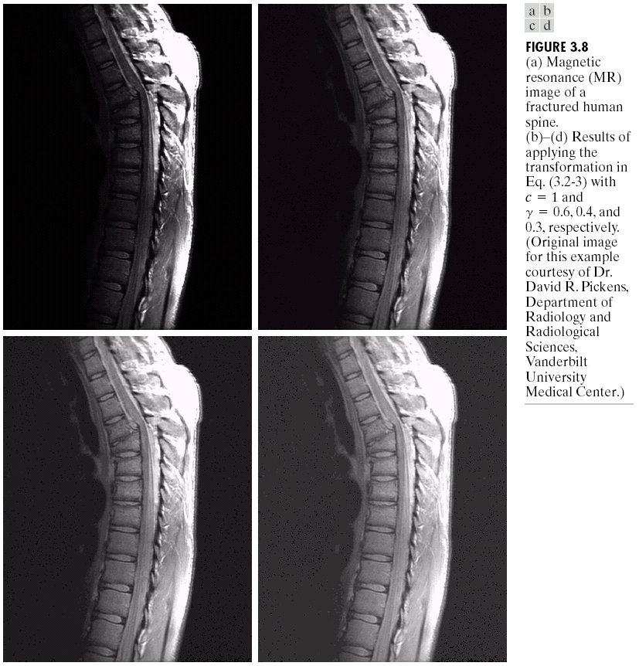
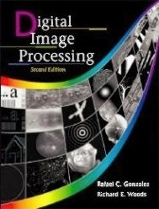
Image Enhancement Examples
Images taken from Gonzalez & Woods, Digital Image Processing (2002)

Slide 9
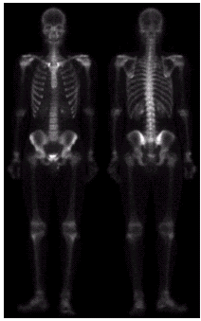
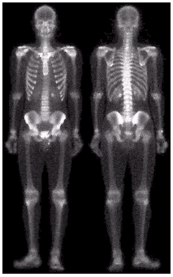
Image Enhancement Examples (cont…)
Images taken from Gonzalez & Woods, Digital Image Processing (2002)

Slide 10
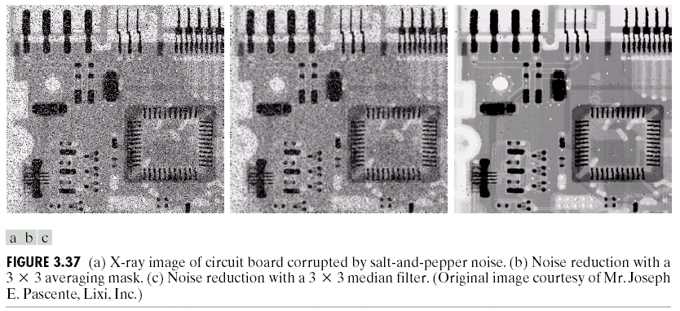
Image Enhancement Examples (cont…)
Images taken from Gonzalez & Woods, Digital Image Processing (2002)

Slide 11
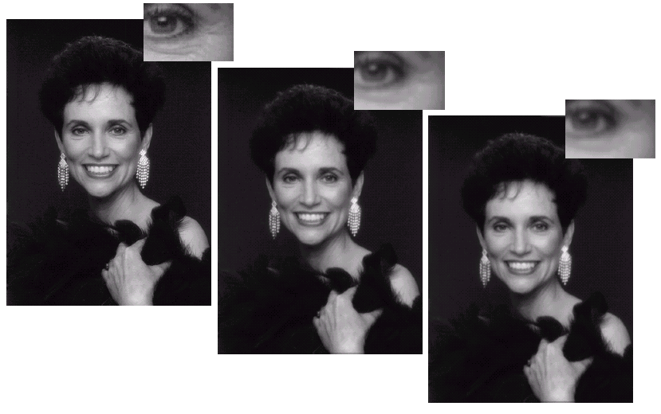
Image Enhancement Examples (cont…)
Images taken from Gonzalez & Woods, Digital Image Processing (2002)

Slide 12
Spatial & Frequency Domains
There are two broad categories of image enhancement techniques
Spatial domain techniques
Direct manipulation of image pixels
Frequency domain techniques
Manipulation of Fourier transform or wavelet transform of an image
For the moment we will concentrate on techniques that operate in the spatial domain

Slide 13
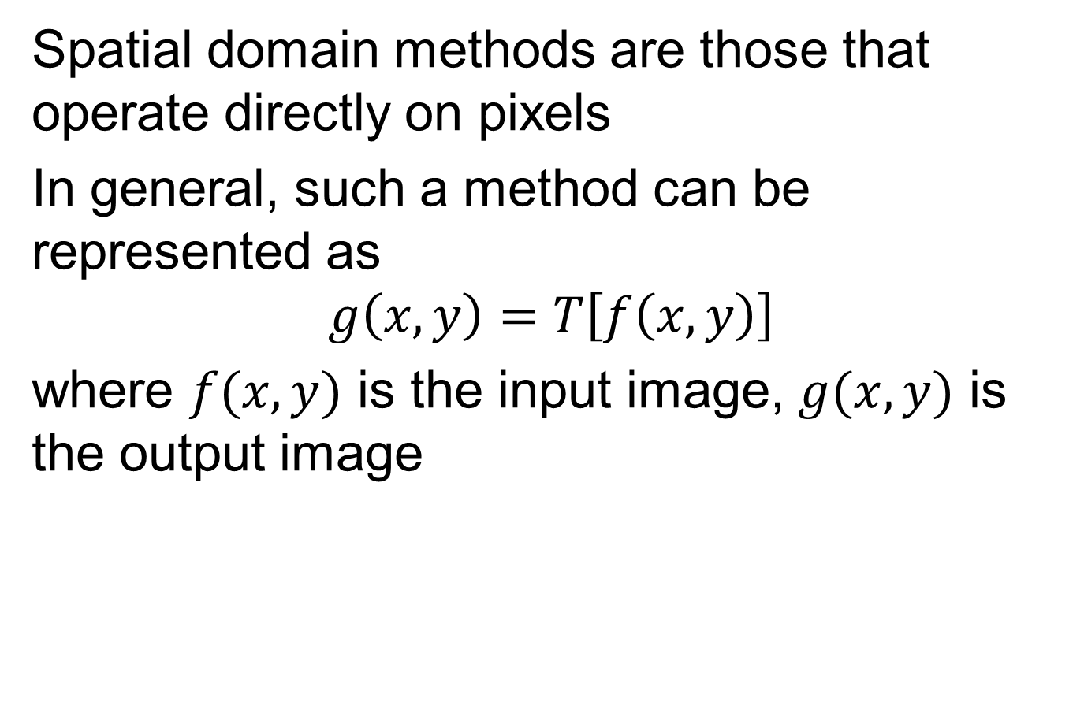
Spatial Domain - Background
Spatial domain methods are those that operate directly on pixels
In general, such a method can be represented as
$$g\left(x,y\right)=T\left[f\left(x,y\right)\right]$$
where $f(x,y)$ is the input image, $g(x,y)$ is the output image

Slide 14
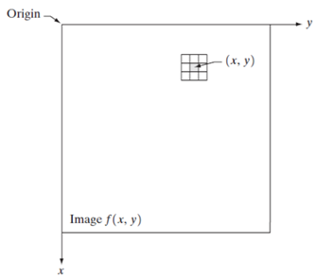
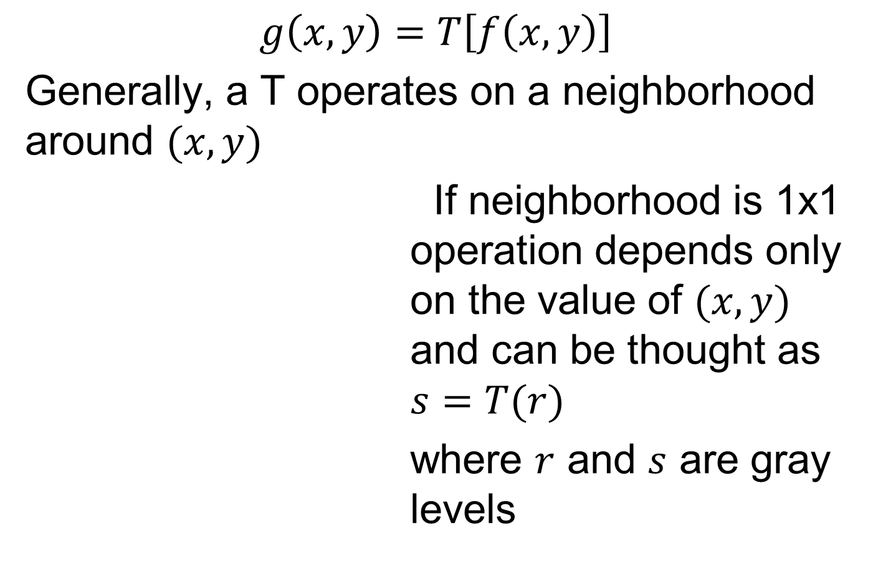
Spatial Domain - Background
$$g\left(x,y\right)=T\left[f\left(x,y\right)\right]$$
Generally, a T operates on a neighborhood around $(x,y)$
If neighborhood is 1x1 operation depends only on the value of $(x,y)$ and can be thought as $s=T(r)$
where $r$ and $s$ are gray levels

Slide 15
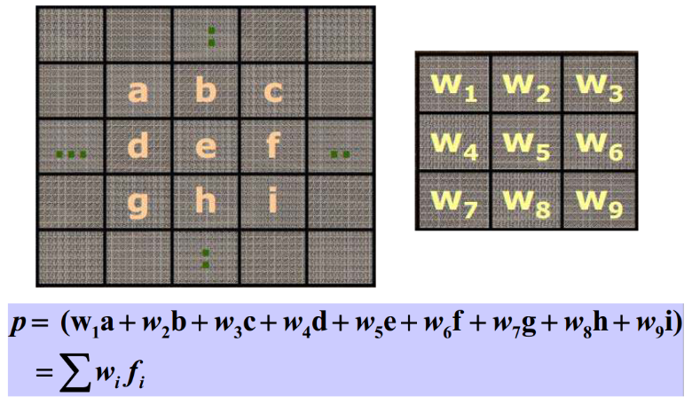
Spatial Domain - Background
Based on using masks (filters, kernels, etc.) Masks are small (e.g. 3x3) 2D arrays which contain values that determine the process.

Slide 16

Spatial Domain - Background
$$s=T(r)$$
If T is as shown below on the left, what will be the effect on the image?

Slide 17

Spatial Domain - Background
$$s=T(r)$$
If T is as shown below on the left, what will be the effect on the image?
Levels below k will become darker and those above k will become lighter (contrast stretching)

Slide 18

Spatial Domain - Background
$$s=T(r)$$
What if T is as shown on the right?

Slide 19

Spatial Domain - Background
$$s=T(r)$$
What if T is as shown on the right?
The result will be a two-level (binary) image (thresholding)
These are point-processing operation examples

Slide 20
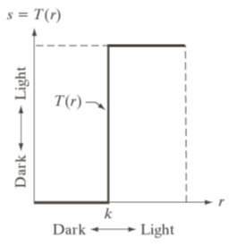
Thresholding - Matlab
function output=threshold(img, thresholdValue)
output=(img>thresholdValue)*255;
img=imread('moon.png');
img=rgb2gray(img);
out=threshold(img, 120);
figure;
subplot(1,2,1); imshow(img);
subplot(1,2,2); imshow(uint8(out));
Read image from graphics file (reads a grayscale or color image from the file specified by the string filename.)

Slide 21
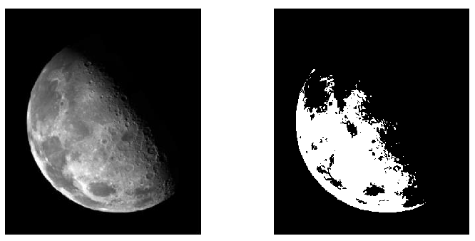
Thresholding - Matlab

Slide 22
Basic Gray Level Transformations
3 basic types of functions are frequently used
- Linear (negative
and identity
transformations)
- Logarithmic (log
and inverse-log
tranformations)
- Power-law (nth
power and nth root
transformations)

Slide 23
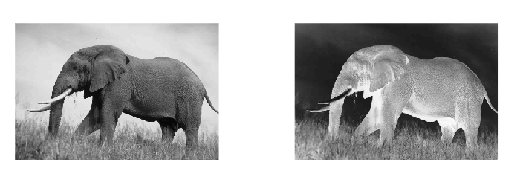
Image Negatives
The function below is used to generate the negative of a given image in range [0, L]:
s = L-r

Slide 24
Image Negative - Matlab
function output=negative(img)
output=255-img;
img=imread('negative.png');
img=rgb2gray(img);
out=negative(img);
figure;
subplot(1,2,1); imshow(img);
subplot(1,2,2); imshow(uint8(out));

Slide 25
Image Negative - Matlab

Slide 26
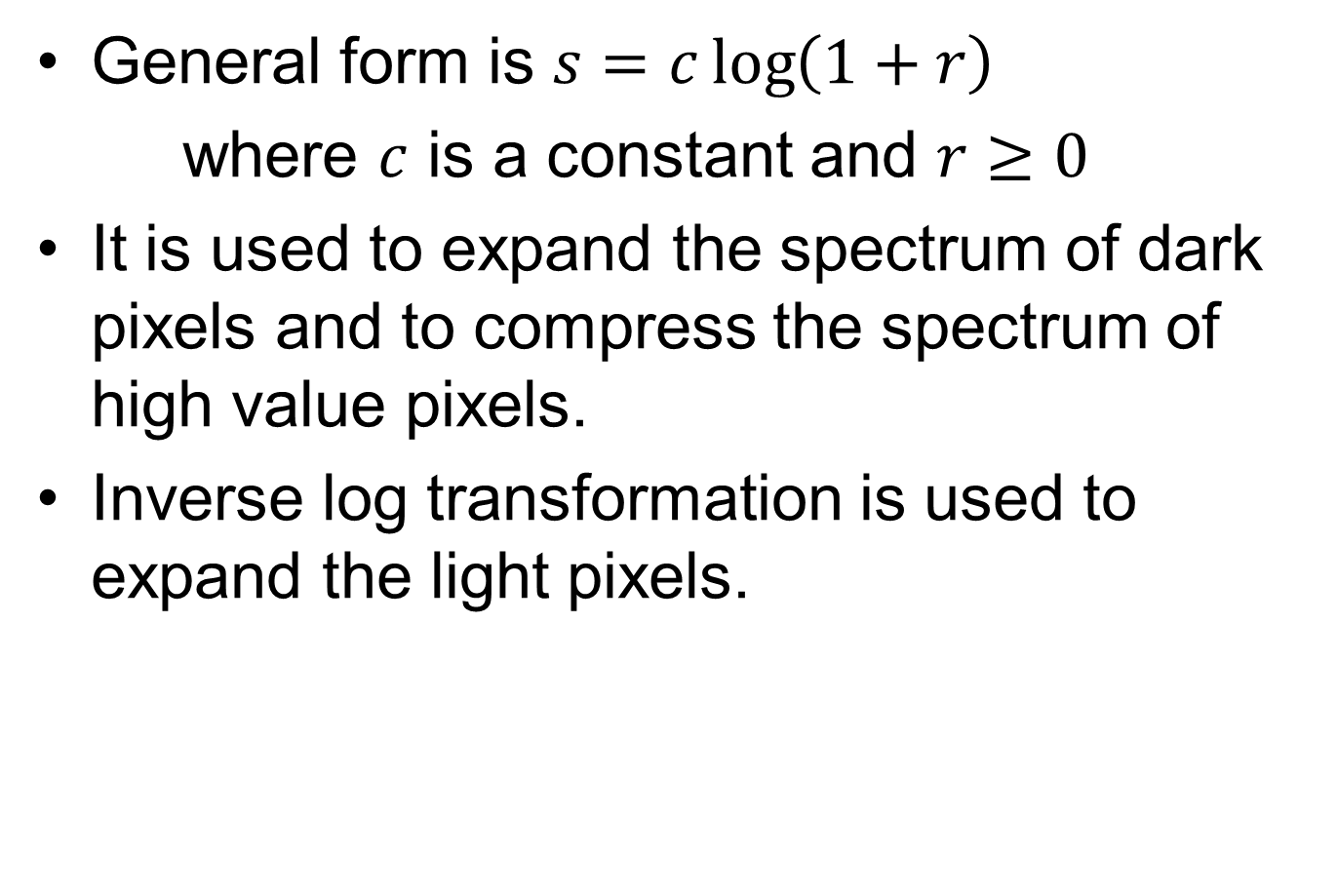
Log Transformations
General form is $s=c\log\left(1+r\right)$
where $c$ is a constant and $r≥0$
It is used to expand the spectrum of dark pixels and to compress the spectrum of high value pixels.
Inverse log transformation is used to expand the light pixels.

Slide 27
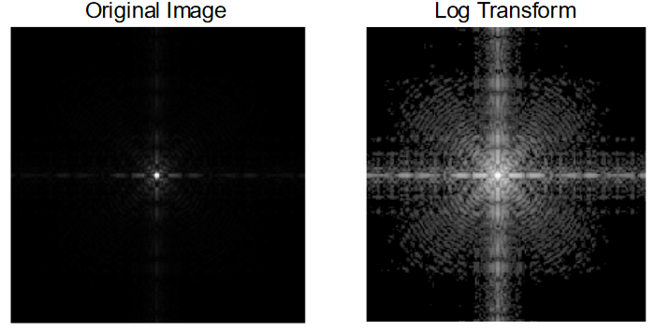
Log Transformations

Slide 28
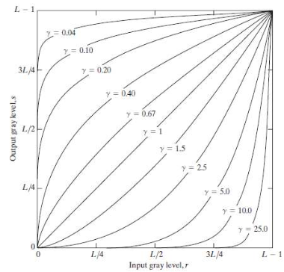
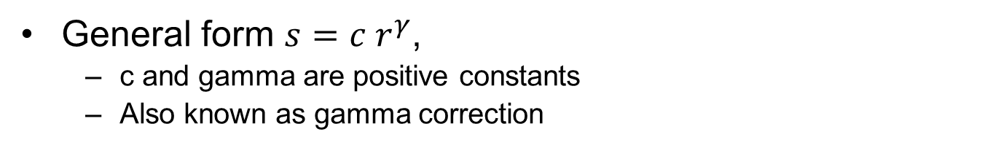
Power-Law Transformations
General form $s=c r^{γ}$,
c and gamma are positive constants
Also known as gamma correction
Provides a more flexible transformation curve compared to log transformations (According to c and γ (gamma) value).
If γ <1:
It expands the spectrum of dark pixels.
Compresses the spectrum of high-value pixels.
If γ> 1:
Compresses the spectrum of dark pixels.
It expands the spectrum of high-value pixels.
If = 1:
It stays the same.

Slide 29
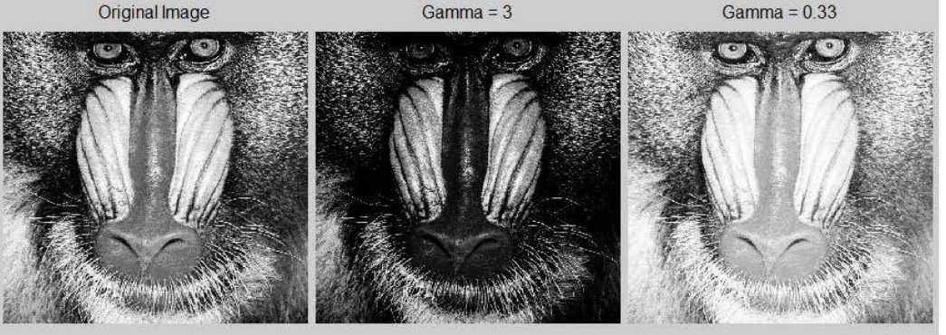
Power-Law Transformations
If γ <1:
It expands the spectrum of dark pixels.
Compresses the spectrum of high-value pixels.
If γ> 1:
Compresses the spectrum of dark pixels.
It expands the spectrum of high-value pixels.

Slide 30
Image Histograms
The histogram of an image shows us the distribution of gray levels in the image.
Massively useful in image processing, especially in segmentation.
Histogram is the discrete function of the digital image.
h(r_{k})=n_{k}
r_{k}=k^{th} gray level and n_{k} is the number of pixels with a gray level r_{k}.

Slide 31
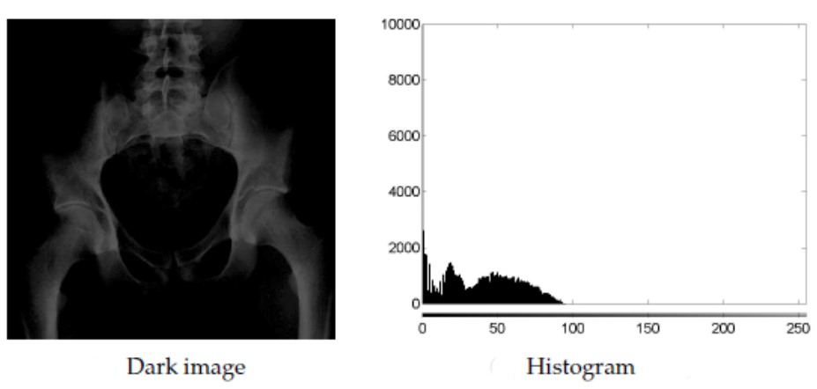
Image Histograms
Dark Image: All pixels are in the range [0, n]. (No pixels in the range [n, L ‐ 1]).

Slide 32
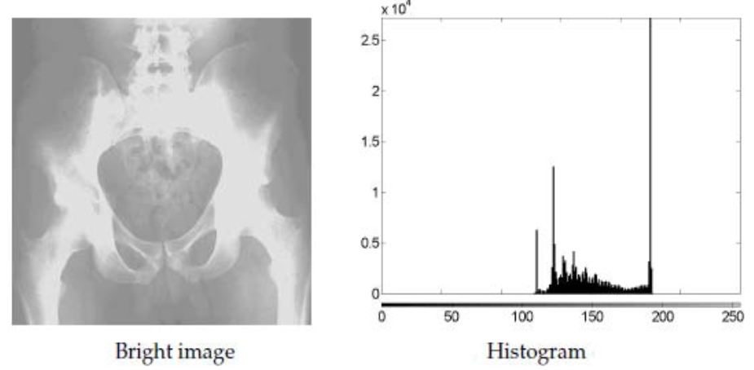
Image Histograms
Bright Image: All pixels are in the range [n, L‐1]. (No pixels in the range [0, n]).

Slide 33
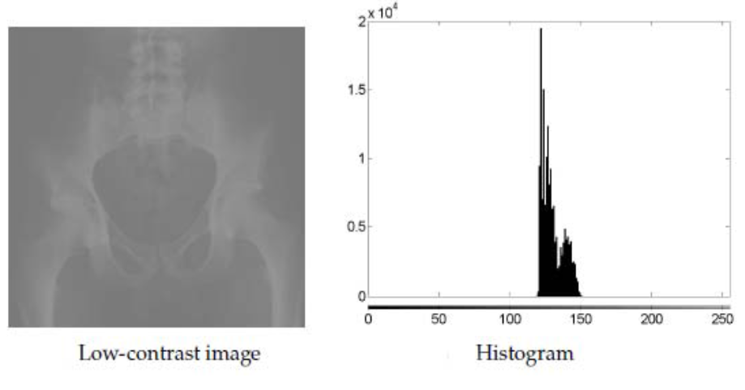
Image Histograms
Low ‐ Contrast Image: All pixels are in the range [n ‐ z, n + z].

Slide 34
Image Histograms -Matlab
function output = generateHistogram(img)
output=zeros(1,256);
[r, c] = size(img);
for i=1:r
for j=1:c
pixel=img(i,j);
output(pixel+1) = output(pixel+1)+1;
end
end
img = imread('darkImage.png');
img=rgb2gray(img);
out = generateHistogram(img);
figure;
subplot(1,2,1); imshow(img);
subplot(1,2,2); bar(out);

Slide 35
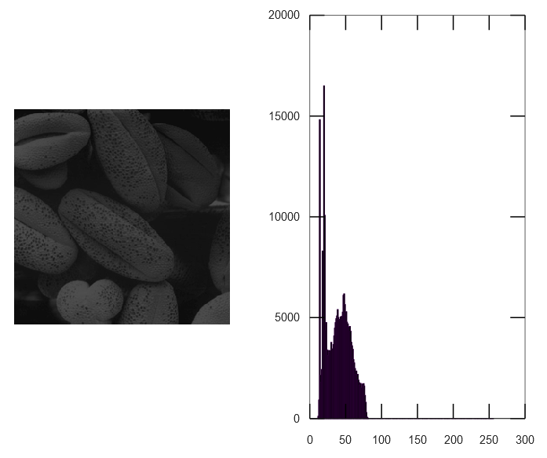
Image Histograms -Matlab

Slide 36
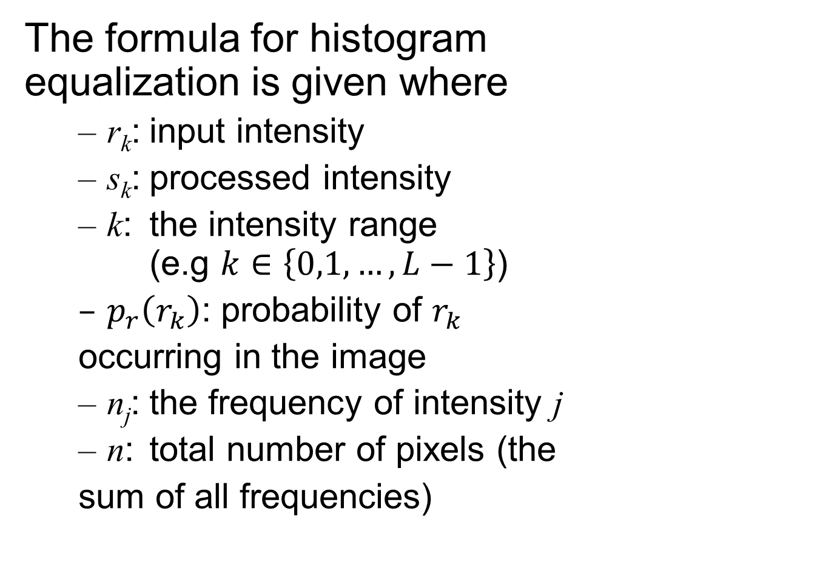
Histogram Equalization
The formula for histogram equalization is given where
r_{k}: input intensity
s_{k}: processed intensity
k: the intensity range (e.g $k∈\left\{0,1,…,L−1\right\}$)
$p_{r}\left(r_{k}\right)$: probability of $r_{k}$
occurring in the image
n_{j}: the frequency of intensity j
n: total number of pixels (the
sum of all frequencies)

Slide 37
Histogram Equalization
Orginal Grayscale Pixel Value | # of Pixels |  | * L | After histogram equalization
0 | 10 | 10/56 | 0.17 * 7 | 1
1 | 8 | 18/56 | 0.32 * 7 | 2
2 | 9 | 27/56 | 0.48* 7 | 3
3 | 2 | 29/56 | 0.52* 7 | 4
4 | 14 | 43/56 | 0.77* 7 | 5
5 | 1 | 44/56 | 0.79* 7 | 6
6 | 5 | 49/56 | 0.88* 7 | 6
7 | 7 | 56/56 | 1* 7 | 7

Slide 38
Histogram Equalization - Matlab
function output = equalizeHistogram(img)
[r,c] = size(img);
output = zeros(r, c);
histogram = generateHistogram(img);
step1 = histogram / (r*c);
step2 = zeros(1,256);
for i=1:256
step2(i)=sum(step1(1:i));
end
eq_histogram = round(255* step2);
for i=1:r
for j=1:c
output(i,j) = eq_histogram(img(i,j)+1);
end
end

Slide 39
Histogram Equalization - Matlab
img = imread('darkImage.png');
img=rgb2gray(img);
out = equalizeHistogram(img);
histogram1 = generateHistogram(img);
histogram2 = generateHistogram(out);
figure;
subplot(2,2,1); imshow(img);
subplot(2,2,2); imshow(uint8(out));
subplot(2,2,3); bar(histogram1);
subplot(2,2,4); bar(histogram2);

Slide 40
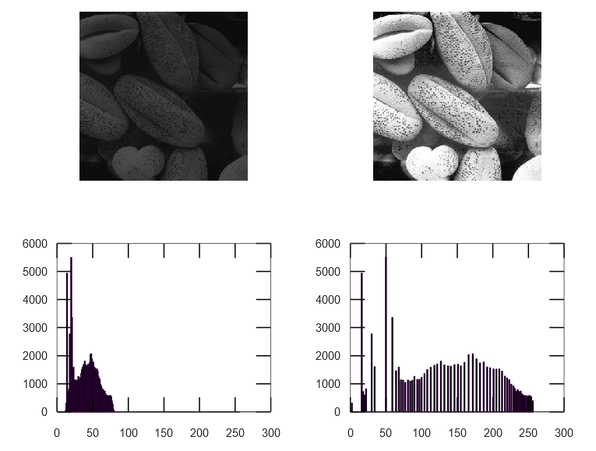
Histogram Equalization - Matlab

